Slide 1

Department of Computer Engineering & Applications
GLA University
Mathura- 281406, INDIA
2020-21

Slide 2
Mini Project Presentation on
Omni Meet
By :
Aditya Kumar Das (181500041)
Gaurav Kumar (181500233)
Vishes Keshari (181500813)
Pulkit Ranjan (181500519)

Slide 3
Introduction
In current scenario, major advancements in technology have drastically changed how and where we conduct business with more people working remotely, the rise of instant, on-demand communications and the globalization of businesses. For modern and innovative businesses to grow and globalize, building and maintaining quality relationships with partners, suppliers, internal teams, investors and customers is essential. Video conferencing boosts productivity, saves time, reduces travel expenses, and overall promotes collaboration. The advantage of video conferencing is the ability to facilitate all of those benefits without requiring constant travel for face-to-face communication.
Video conferencing describes online meetings that take place over the internet to connect video conferencing systems in meeting rooms with personal devices such as laptops or mobile devices with embedded webcams. Utilizing a simple, unified video conferencing solution with support for screen sharing empowers your global teams to be more connected, productive and engaged.

Slide 4
Problem Statement and Objective
This project is to create a application with a server and client that enables video conferencing and texting in real-time.
This project is a real-time web application with very simple UI.
Users can do video conferencing with control over their video and audio streaming.
Users can send and receive text in real-time in the room.
To generate an IP Address for multiple users to connect to the same chat room.

Slide 5
Projects has 3 functionalities
1. Video Streaming
2. Audio Streaming
3. Real-time Chatting
.

Slide 6
1. Video Streaming
By video streaming we allow users in different locations to communicate face-to-face using live video stream without having to move to a single location together in a same virtual room. We can also control the stream using on-screen button. This technology is particularly convenient for business users in different cities or even different countries because it saves time, expenses, and hassles associated with business travel. Uses for video conferencing include holding routine meetings, negotiating business deals, and interviewing job candidates.

Slide 7
2. Audio Streaming
By audio streaming we allow users in different locations to communicate through audio using live real-time audio stream without having to move to a single location together in a same virtual room. We can also control the stream using on-screen button. This technology works parallelly with the video stream and support fully functional Audio-Video Conference.

Slide 8
3. Real Time Chatting
By this technology, we allow users to communicate in real-time via text messages in the chat box attached in the app. This helps users to ask their doubts, discuss them and send messages. This feature help to conduct non verbal communication and thus increases the functionality of the app.

Slide 9
Hardware Requirements:
Processor i3 (7th Gen) or AMD A6-7310 APU processor
2 GB RAM
1GHz or more
64-bit Operating System
minimum 25 GB Hard Disk Space
Internet Connection
Software Requirements:
Editor : Visual Studio Code
Web browser : Google Chrome
Node.js

Slide 10
Technical Knowledge required

Slide 11
HTML
HTML stands for Hyper Text Mark-up Language
HTML is the standard mark-up language for creating Web pages
HTML describes the structure of a Web page
HTML consists of a series of elements
HTML elements tell the browser how to display the content
HTML elements label pieces of content such as "this is a heading", "this is a paragraph", "this is a link", etc.

Slide 12
2. CSS
CSS stands for Cascading Style Sheets
CSS describes how HTML elements are to be displayed on screen, paper, or in other media
CSS saves a lot of work. It can control the layout of multiple web pages all at once
External stylesheets are stored in CSS files

Slide 13
3. JavaScript
JavaScript is a very powerful client-side scripting language. JavaScript is used mainly for enhancing the interaction of a user with the webpage. In other words, you can make your webpage more lively and interactive, with the help of JavaScript. JavaScript is also being used widely in game development and mobile application development.

Slide 14
4. Node.js
This is in contrast to today's more common concurrency model, in which OS threads are employed. Thread-based networking is relatively inefficient and very difficult to use. Furthermore, users of Node.js are free from worries of dead-locking the process, since there are no locks. Almost no function in Node.js directly performs I/O, so the process never blocks. Because nothing blocks, scalable systems are very reasonable to develop in Node.js.
5. Nodemon
Nodemon is a tool that helps develop node.js based applications by automatically restarting the node application when file changes in the directory are detected.

Slide 15
6. Socket.IO
Socket.IO enables real-time, bidirectional and event-based communication. It works on every platform, browser or device, focusing equally on reliability and speed.
Real-time analytics Push data to clients that gets represented as real-time counters, charts or logs.
Binary streaming: - Starting in 1.0, it's possible to send any blob back and forth: image, audio, video.
Instant messaging and chat Socket.io’s .
Document collaboration Allow users to concurrently edit a document and see each other's changes

Slide 16
7. Express
Express is a minimal and flexible Node.js web application framework that provides a robust set of features to develop web and mobile applications. It facilitates the rapid development of Node based Web applications.
Following are the features of Express :
Allows to set up middleware to respond to HTTP Requests.
Defines a routing table which is used to perform different actions based on HTTP Method and URL.
Allows to dynamically render HTML Pages based on passing arguments to templates.

Slide 17
8. npm
npm , Inc. is a company founded in 2014, and was acquired by GitHub in 2020. npm is a critical part of the JavaScript community and helps support one of the largest developer ecosystems in the world.
npm is lots of things.
npm is the package manager for Node.js. It was created in 2009 as an open source project to help JavaScript developers easily share packaged modules of code.
The npm Registry is a public collection of packages of open-source code for Node.js, front-end web apps, mobile apps, robots, routers, and countless other needs of the JavaScript community.
npm is the command line client that allows developers to install and publish those packages.

Slide 18
Implementation Details
First we worked on making design for our website using pencil wireframe.
Next, we Initialized our NodeJS Project.
Then we Initialized our first view Using HTML.
After initializing first view we created a Room ID.
Then we added the ability to view our own video.
Soon after above we added ability to allow others to stream their video.
Then we added Styling Using CSS.
After adding Styling we added the ability to create messages.
Followed by adding mute button.
Then at last we added Stop Video Button too.

Slide 19
Coding Screenshots

Slide 20
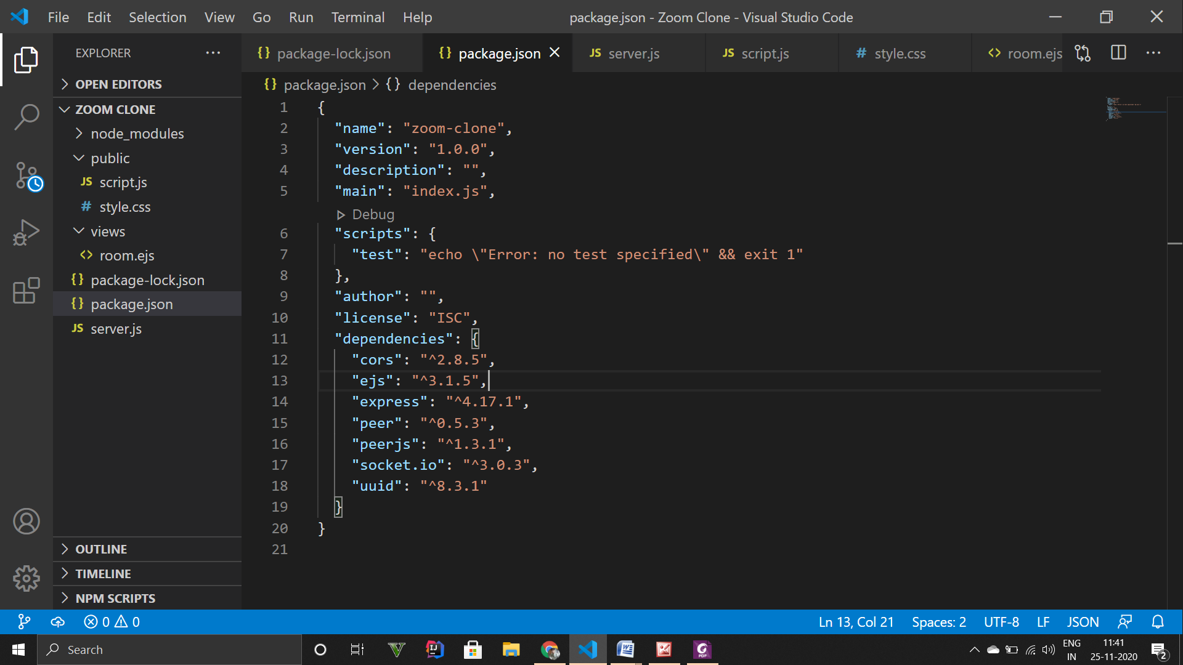

Slide 21
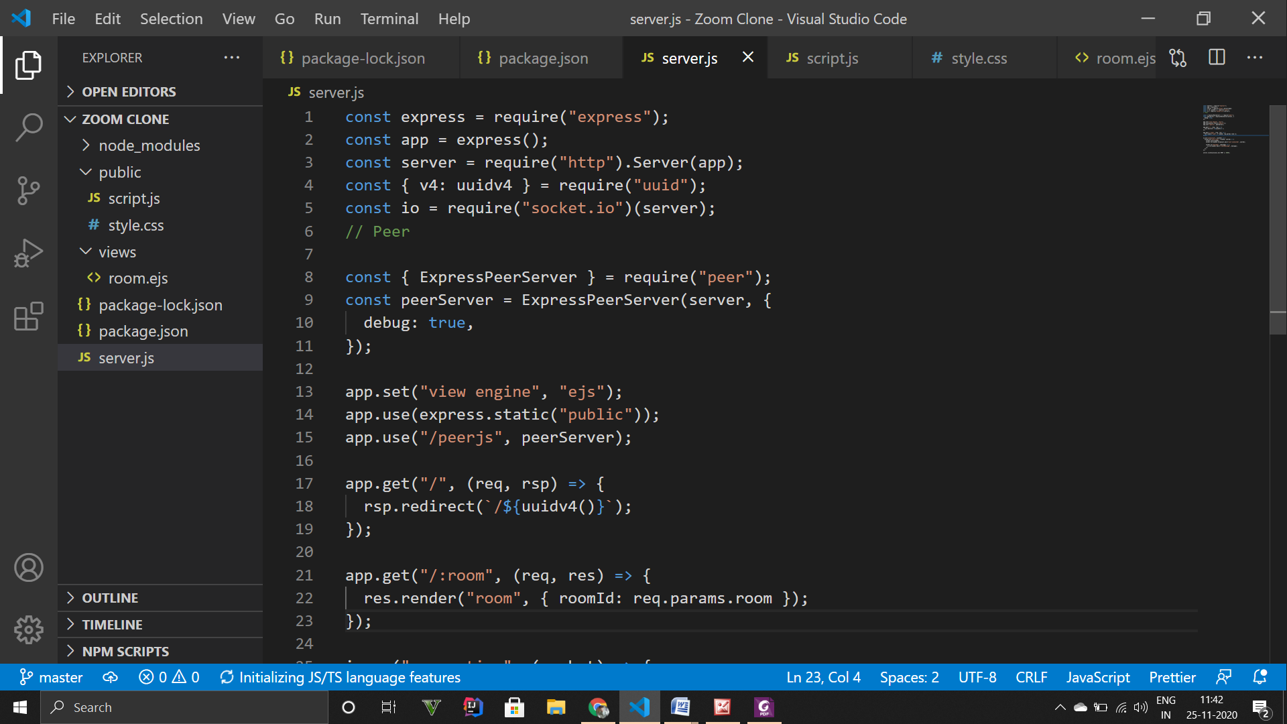

Slide 22
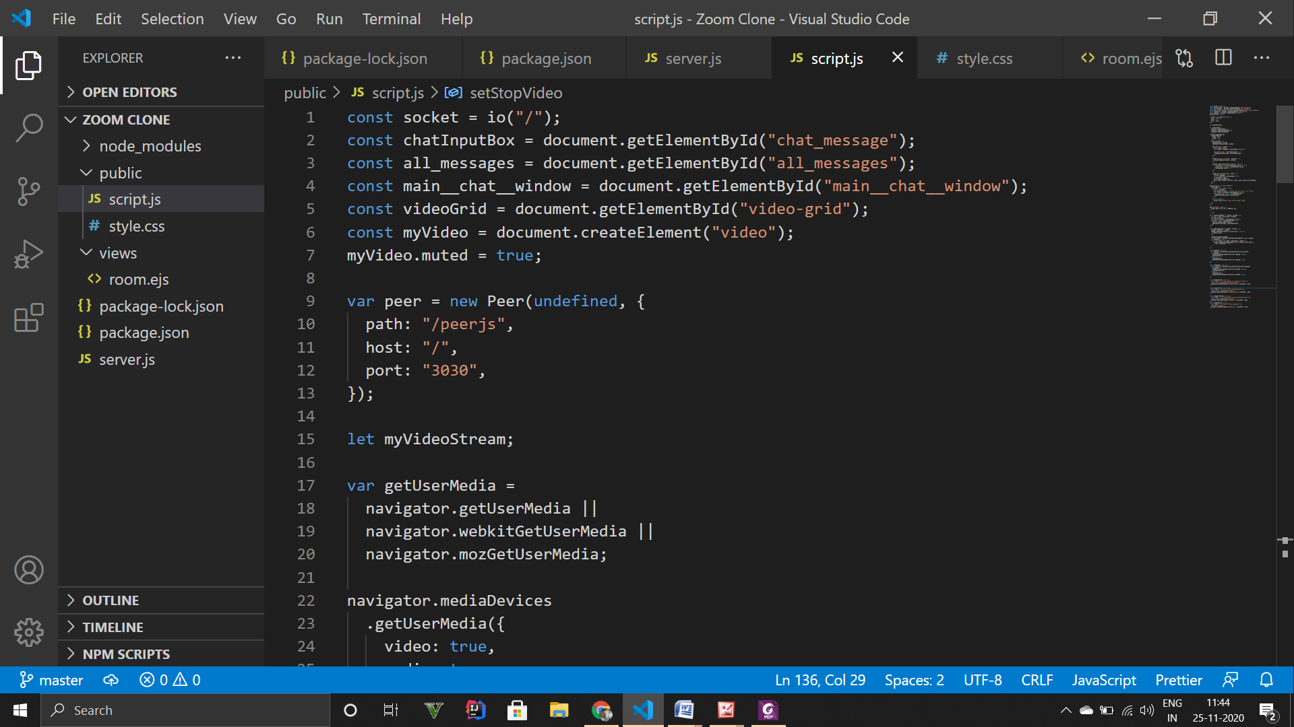

Slide 23
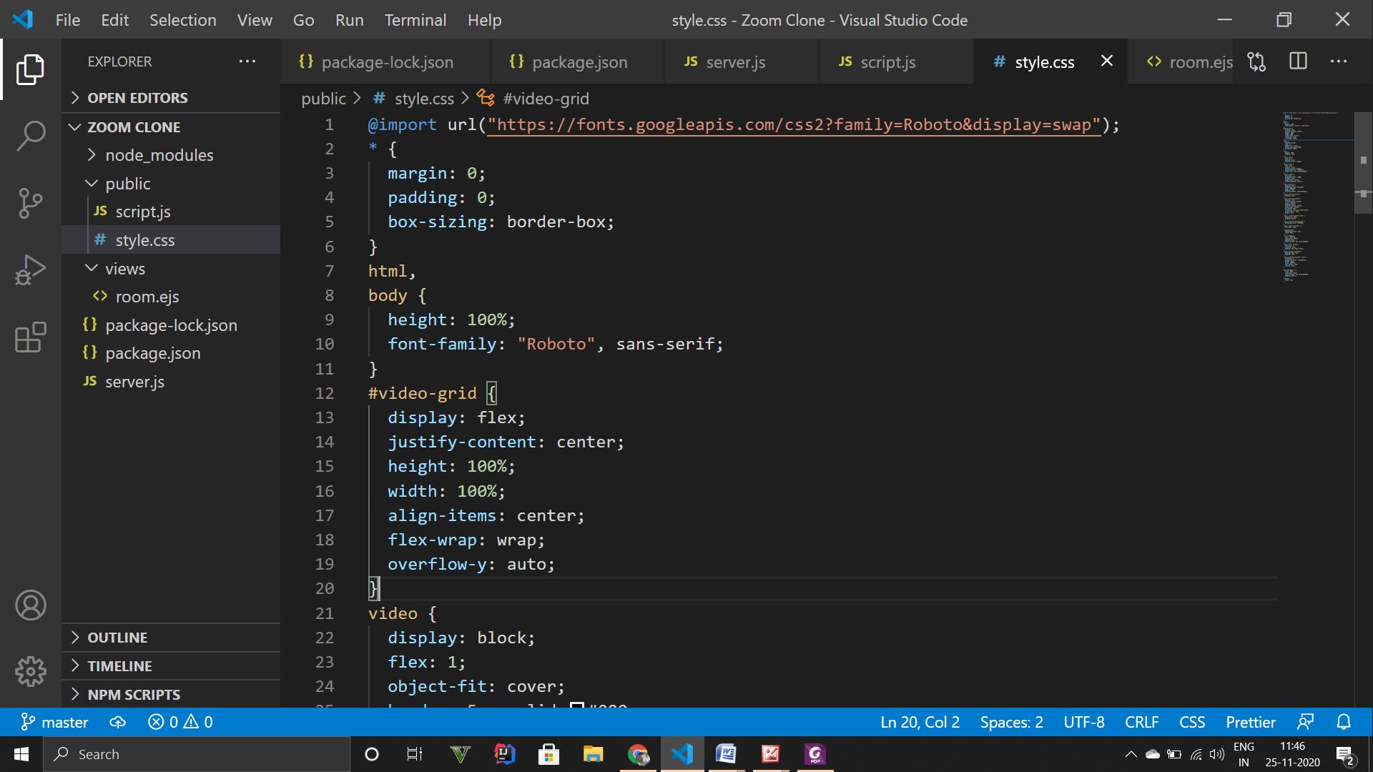

Slide 24
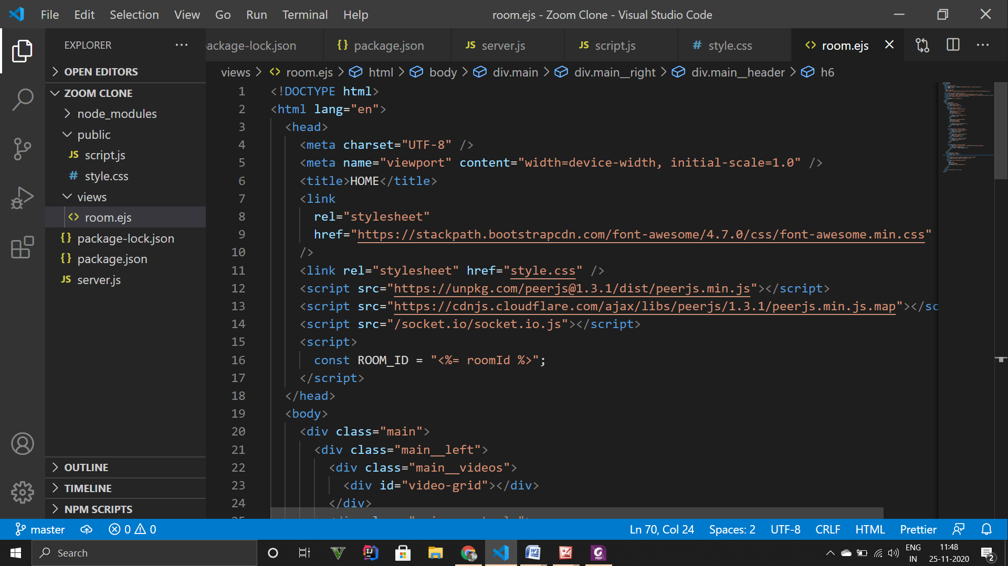

Slide 25
Implementation
(Here are some Screenshots of the project)

Slide 26
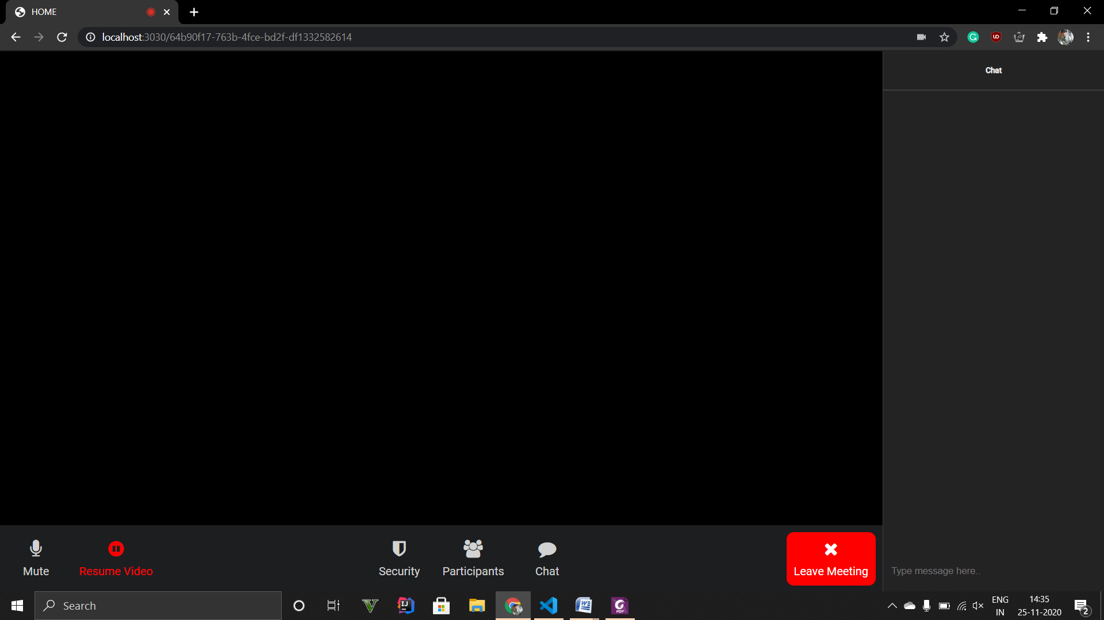

Slide 27
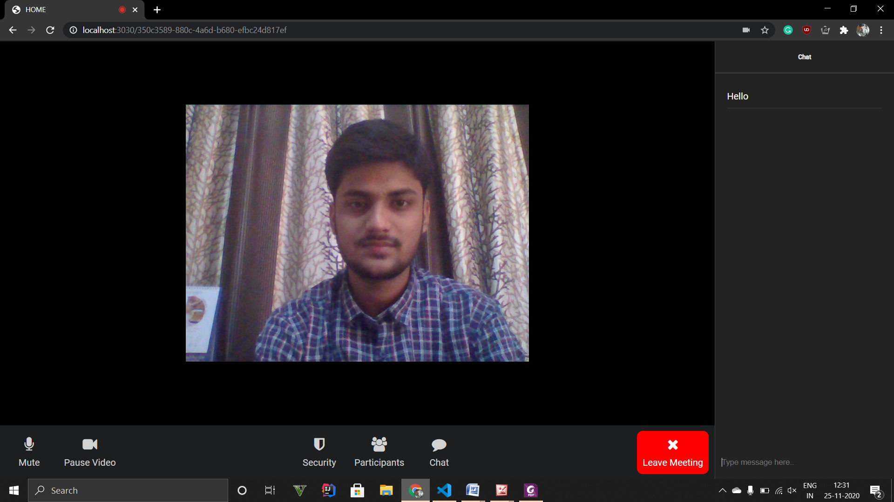

Slide 28
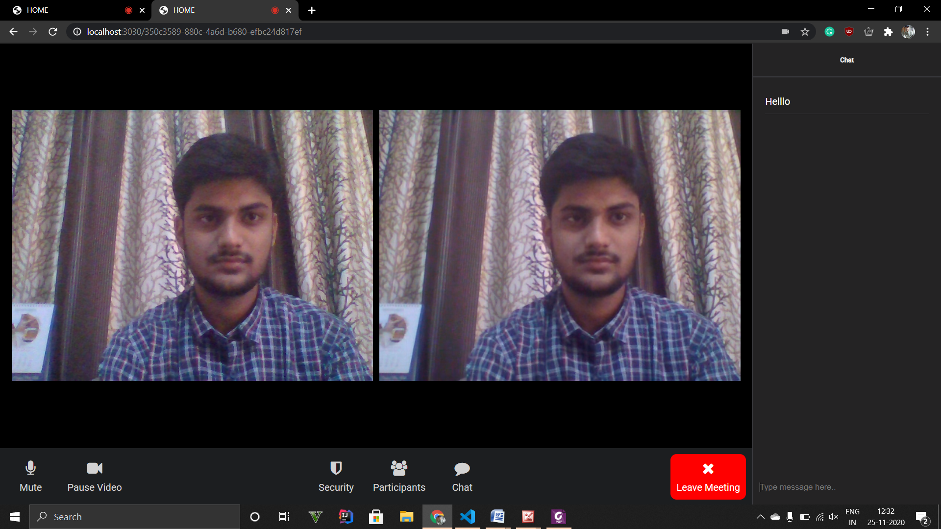

Slide 29
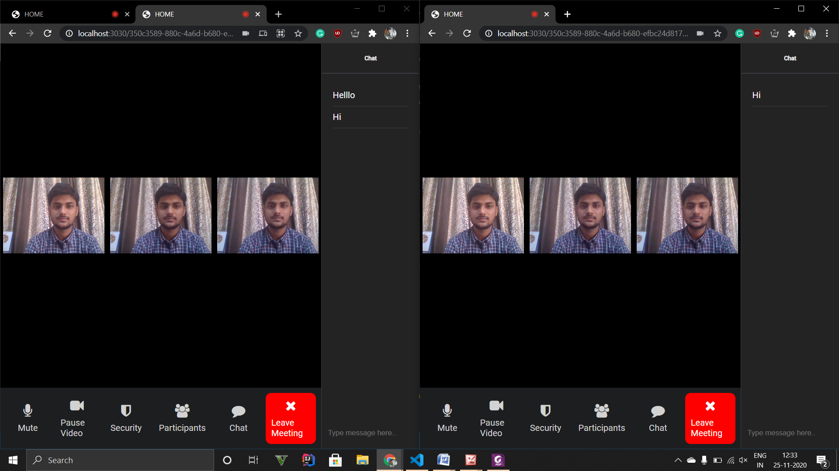

Slide 30
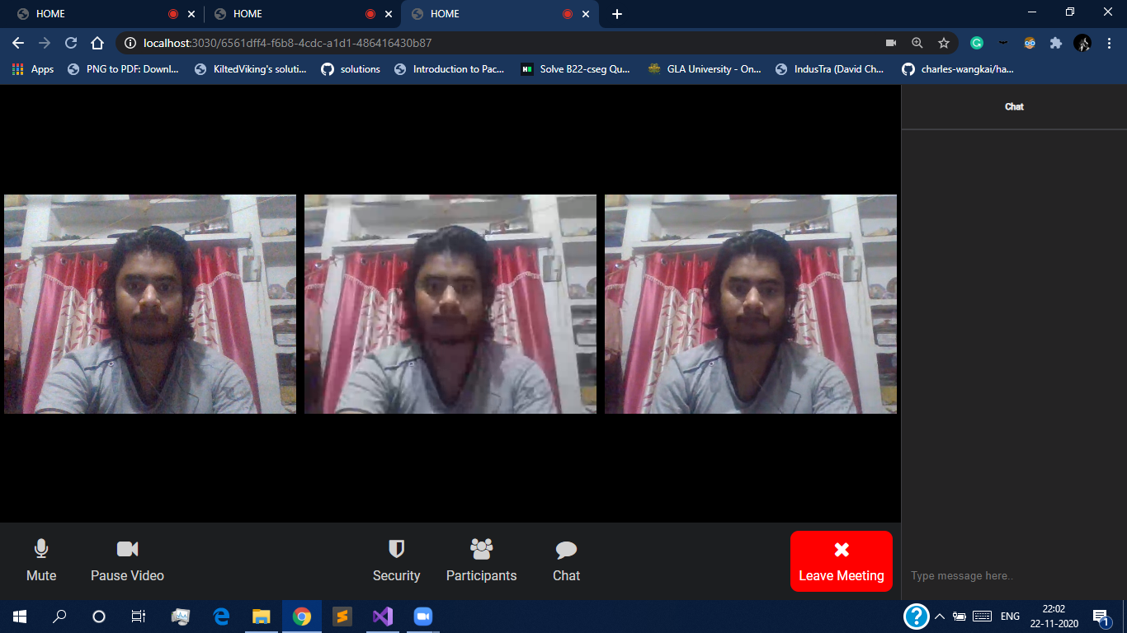

Slide 31
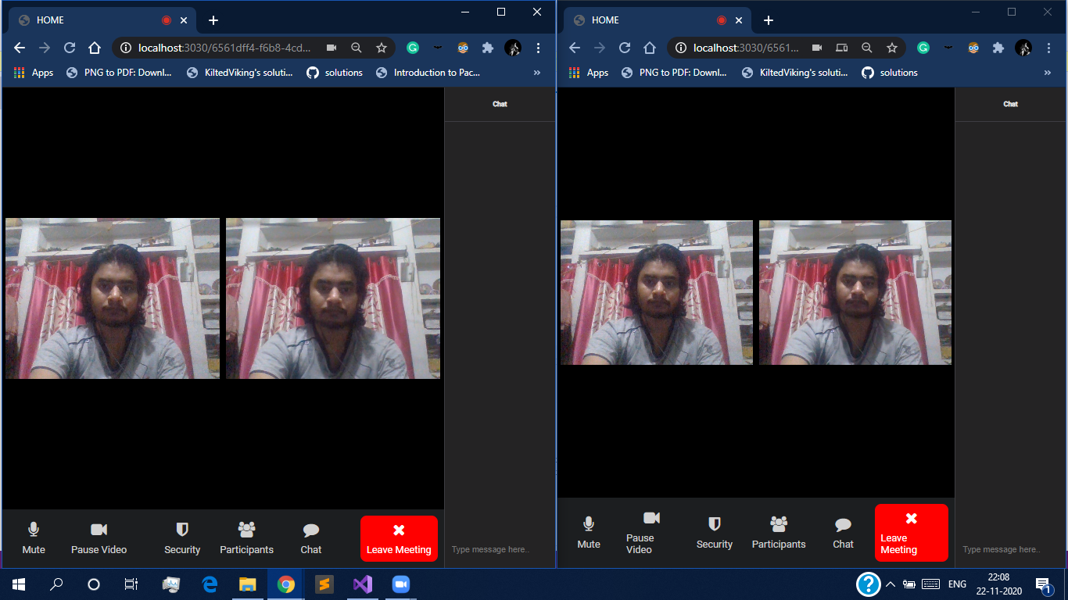

Slide 32
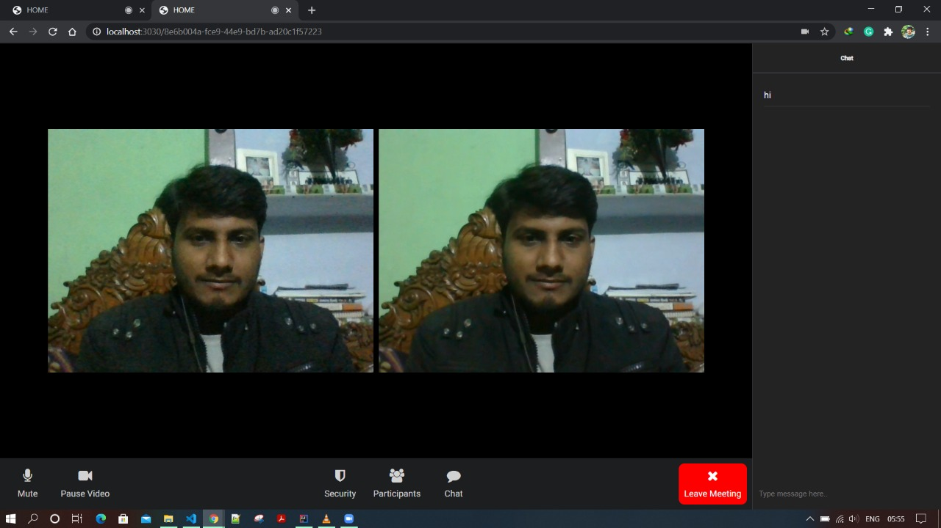

Slide 33
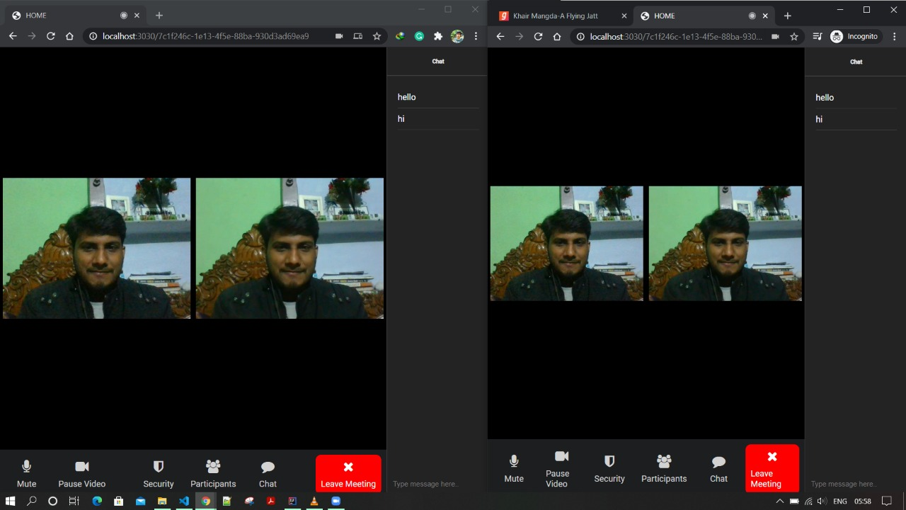

Slide 34
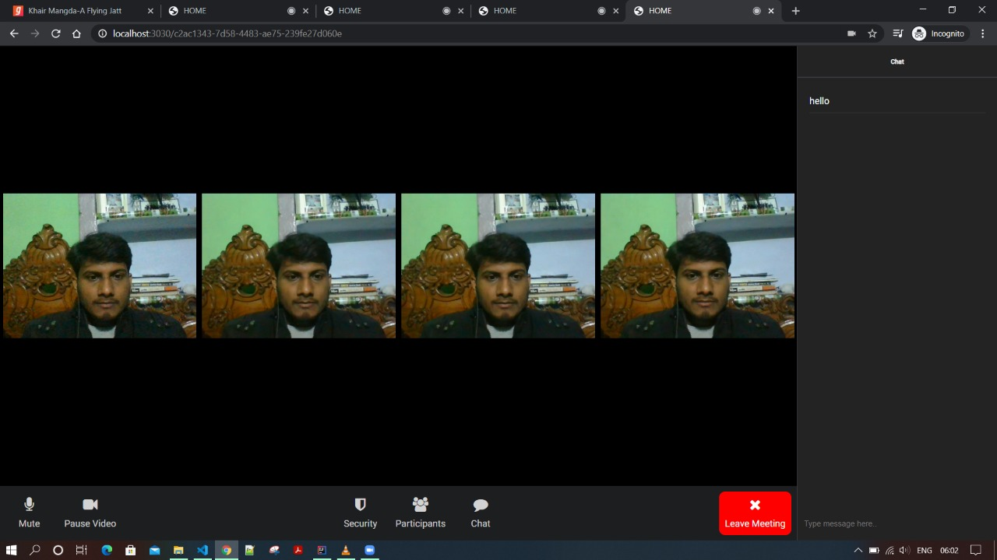

Slide 35
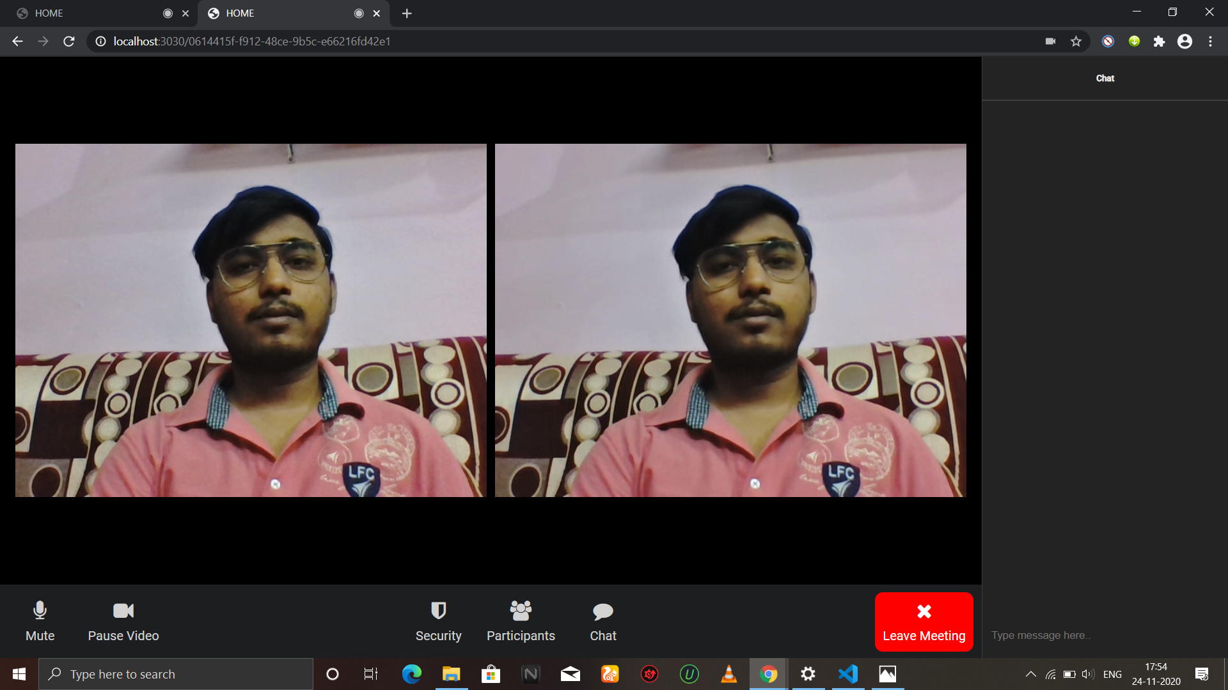

Slide 36
Limitations
The only limitation of this project is that it is not yet deployed globally on internet. It runs on a local server.

Slide 37
Future Scope
Since this project works on a local server, in future we can deploy it globally so different users from any part of the world can join the room.
We can add Database in the application which enable us to introduce features like Unique ID, Sign Up, Profile Photo Update, Sharing Screen or Media and Document Share, etc.

Slide 38
GitHub Link: https://github.com/visheskeshari/ZoomClone
Reference and bibliography
https://nodejs.org/en/
https://socket.io/
https://socket.io/
https://youtu.be/JnvKXcSI7yk
https://www.geeksforgeeks.org

Slide 39
Thank You

